Slide 1

Python for Physics
By
Rabia Tabassum
Assistant Professor

Slide 2
Key topics Covered
Introduction to Jupiter Notebook .
Introduction to Basics of Python.
Python libraries ( Numpy and Matplotlib)
Programming the main topics of Physics:
Vectors
Motion & Free Fall Motion
Projectile motion
Simple Harmonic Motion & Damped Oscillation
Circular Motion &SHM
Wave Motion
Electrostatics Force and Field
Gravitational Field

Slide 3
What is Python
Python is a widely used general-purpose high level programming language, designed by Guido van Rossum in 1991.
Why Python
Python has several advantages over other programming languages. They are:
Code readability
Easy syntax
English like keywords
Concise programs
Automatic Memory languages
Free and open source software

Slide 4
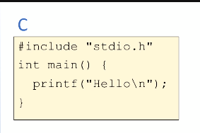
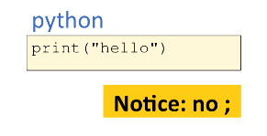
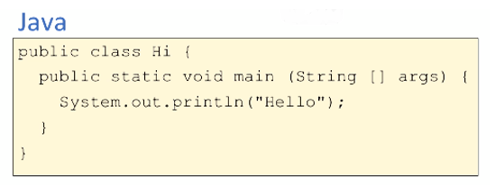
Python comparing with C

Slide 5
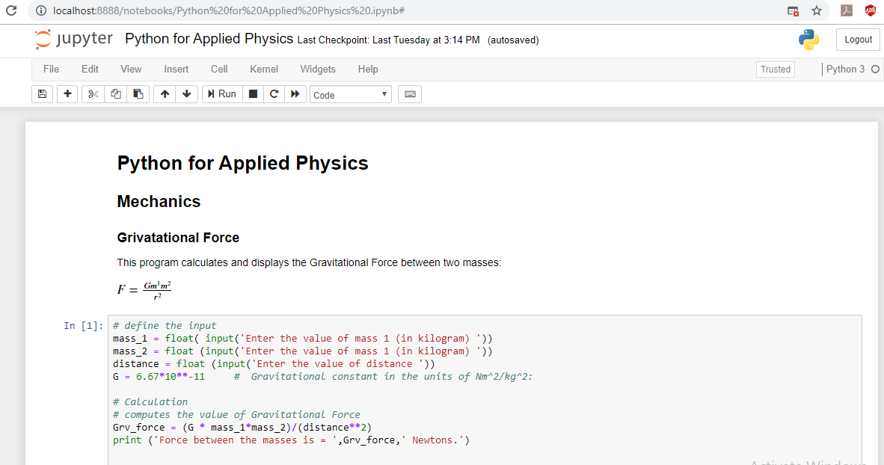

Slide 6

Introduction to Jupiter Notebook
The Jupyter Notebook is an open-source web application that allows us to create and share documents that contain live code, equations, visualizations and narrative text. Uses include: data cleaning and transformation, numerical simulation, statistical modeling, data visualization, machine learning, and much more.
A single document that combines explanations with executable code and its output — an ideal way to provide:
reproducible research results
documentation of processes
instructions
tutorials and training materials of all shapes and sizes

Slide 7
Installation
The easiest way for a beginner to get started with Jupyter Notebooks is by installing Anaconda.
Link for installing Anaconda is:
https://www.anaconda.com/products/individual
Anaconda is the most widely used Python distribution for data science and comes pre-loaded with all the most popular libraries and tools.
Some of the biggest Python libraries included in Anaconda include NumPy, pandas, and Matplotlib, though the full 1000+ list is exhaustive.

Slide 8
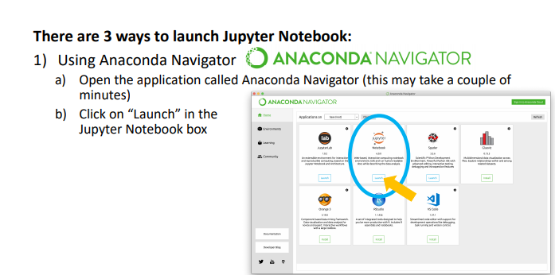
How to Launch Jupyter Notebook

Slide 9
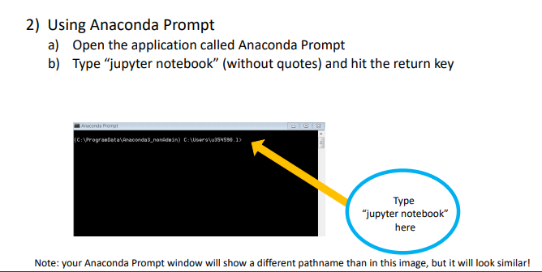
How to Launch Jupyter Notebook

Slide 10
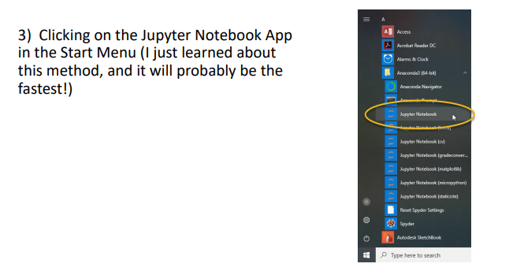
How to Launch Jupyter Notebook

Slide 11
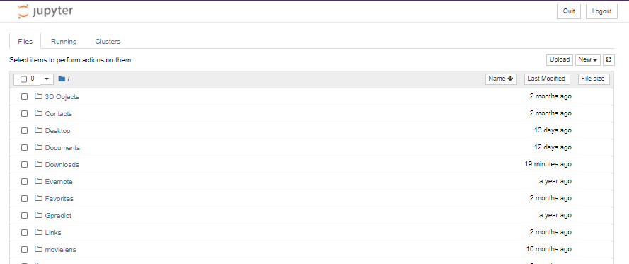
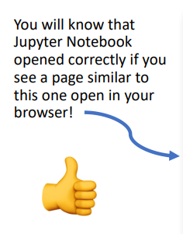
How to Launch Jupyter Notebook

Slide 12
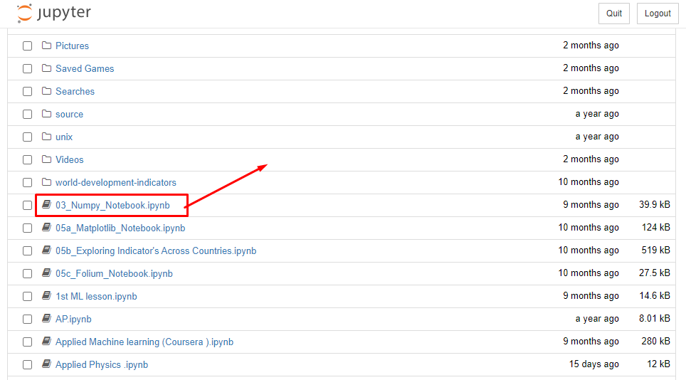
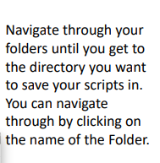
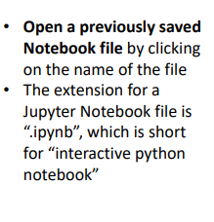
How to open a Notebook file

Slide 13
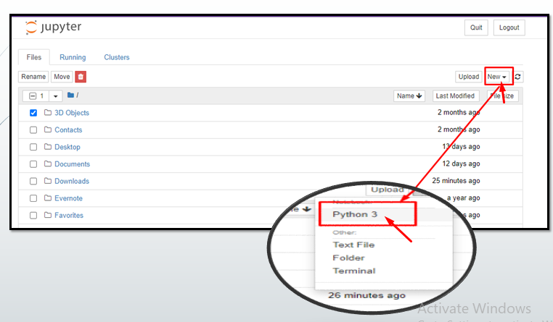
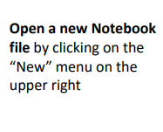
How to open a Notebook file

Slide 14
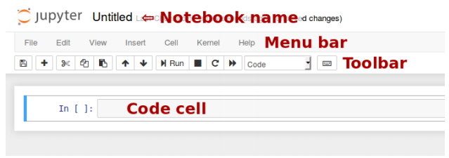

How to start writing a Jupyter Notebook
Notebook name: The name displayed at the top of the page, next to the Jupyter logo, reflects the name of the . ipynb file. Clicking on the notebook name brings up a dialog which allows you to rename it. Thus, renaming a notebook from “Untitled0” to “My first notebook” in the browser, renames the Untitled0.ipynb file to My first notebook.ipynb.
Menu bar: The menu bar presents different options that may be used to manipulate the way the notebook functions.
Toolbar: The tool bar gives a quick way of performing the most-used operations within the notebook, by clicking on an icon.
Code cell: the default type of cell; read on for an explanation of cells

Slide 15
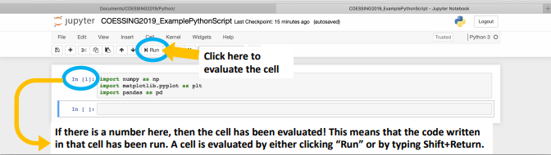
How to start writing a Jupyter Notebook
It’s good practice to start your script by importing libraries you will need.
Below are three libraries I often use, but you may need different ones.

Slide 16
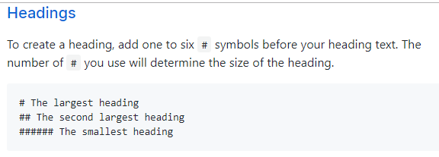
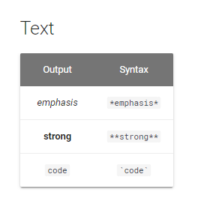

Markdown

Slide 17
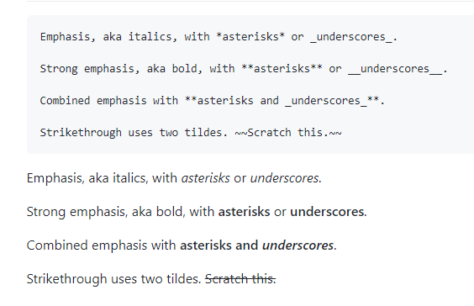

Slide 18
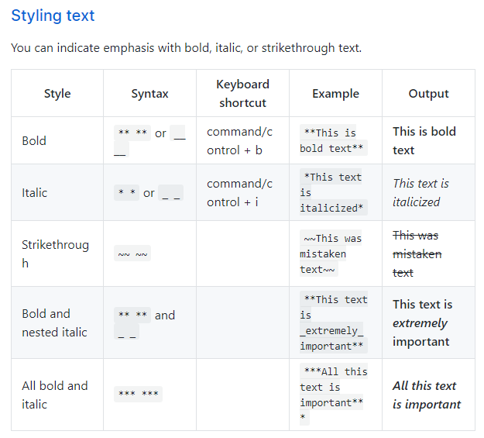

Slide 19
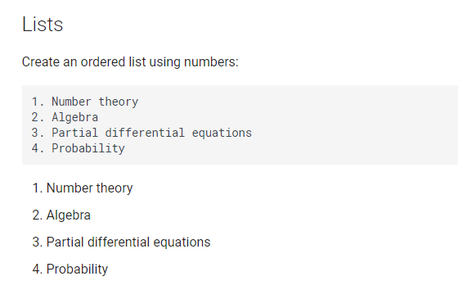
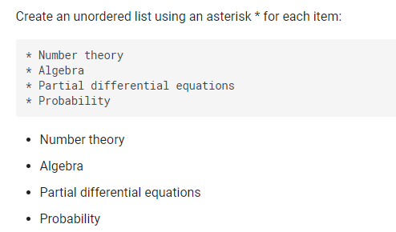

Slide 20
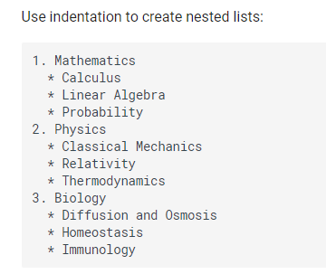
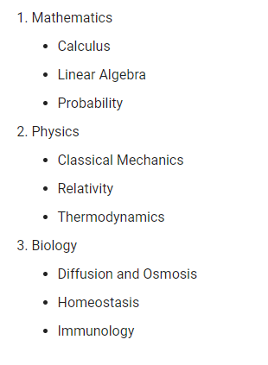

Slide 21
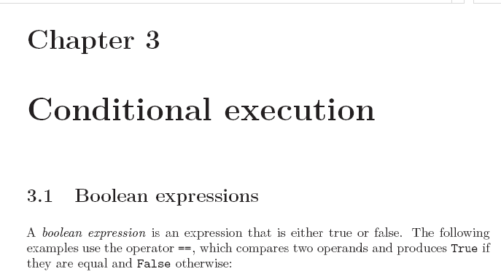
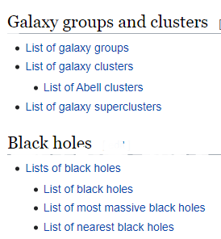
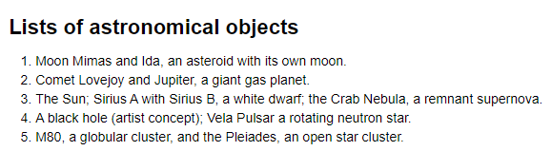
Goal Lab-1
Prepare the code of the following three output on Jupyter notebook using markdown

